Slide 1
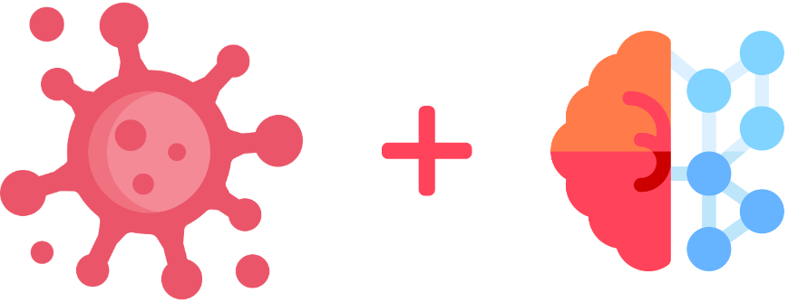
HACKAITHON
CORONAI

Slide 2
WELCOME
CORONAI

Slide 3
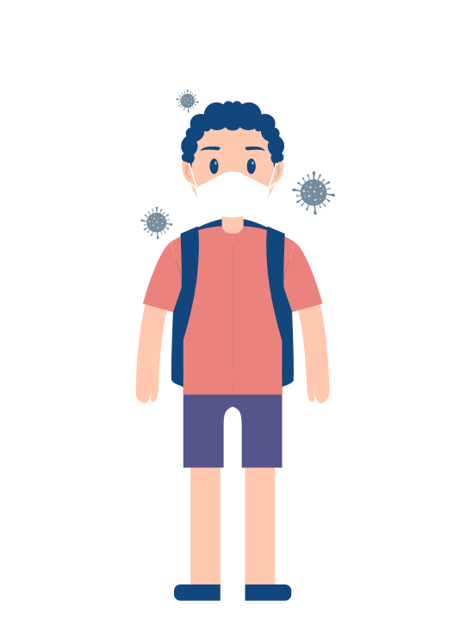
ABOUT
Why Corona ?
Coronaviruses are a group of related RNA viruses that cause diseases in mammals and birds. In humans and birds, they cause respiratory tract infections that can range from mild to lethal. Mild illnesses in humans include some cases of the common cold (which is also caused by other viruses, predominantly rhinoviruses), while more lethal varieties can cause SARS, MERS, and COVID-19.

Slide 4
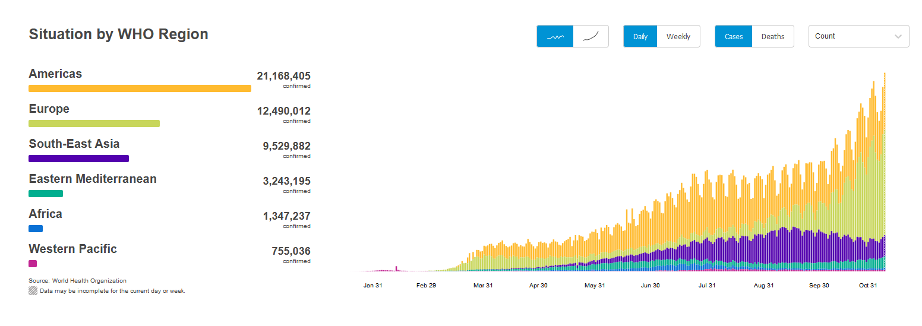
STATISTICS

Slide 5


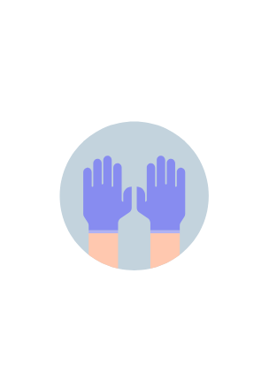
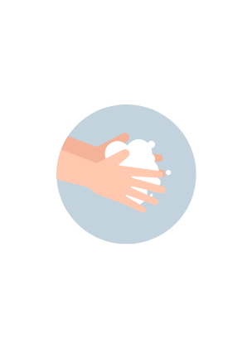
GUIDELINES
Use Sanitizer
Wear Mask
Use Gloves
Wash Hands
Use an alcohol-based hand sanitizer that contains at least 60 percent alcohol (also referred to as ethanol or ethyl alcohol).
Wear masks with two or more layers to stop the spread of COVID-19 Wear the mask over your nose and mouth and secure it under your chin
Use disposable gloves when cleaning and disinfecting the area around the person who is sick or other surfaces.
Washing hands often with soap and water for at least 20 seconds is essential.

Slide 6
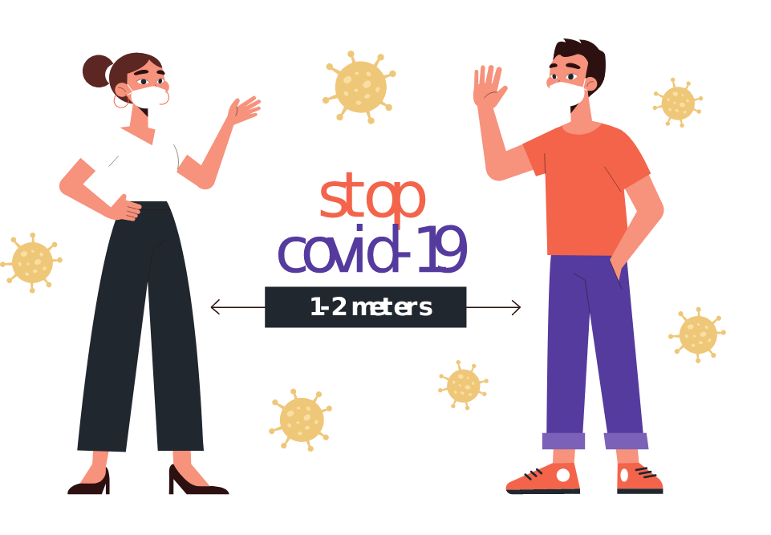

Slide 7
OUR SOLUTION
CORONAI

Slide 8





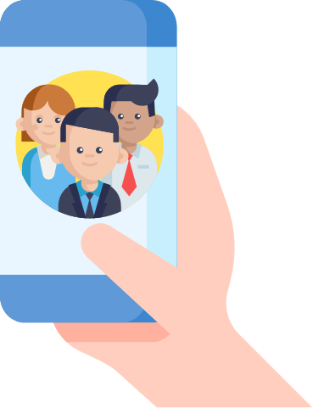
<1m
STAY AWAY

Slide 9
ARCHITECTURAL DESIGN
CORONAI

Slide 10



CORONAI

Slide 11
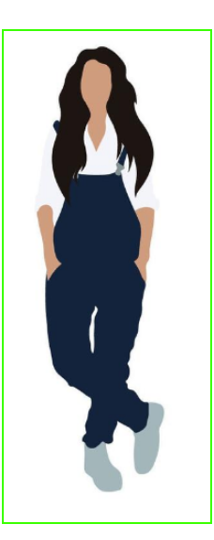
HUMAN DETECTION
Human Detection is a branch of Object Detection. Object Detection is the task of identifying the presence of predefined types of objects in an image. This task involves both identification of the presence of the objects and identification of the rectangular boundary surrounding each object (i.e. Object Localization). An object detection system which can detect the class “Human” can work as a Human Detection System.

Slide 12
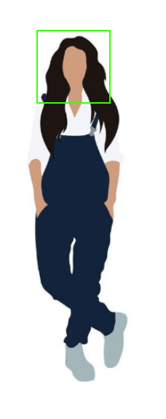
FACE DETECTION
Face detection using Haar cascades is a machine learning based approach where a cascade function is trained with a set of input data. OpenCV already contains many pre-trained classifiers for face, eyes, smiles, etc..
The image to be used is divided into different kinds of sub-windows and multiple Haar-like features to compute it at different scales and positions for each sub-window. The main features are selected using the Adaboost algorithm. Then each sub-window is checked for the presence or absence of face using a cascade of classifiers.

Slide 13


Thank You!

Slide 14

APP DEMO
CORONAI

